Slide 2
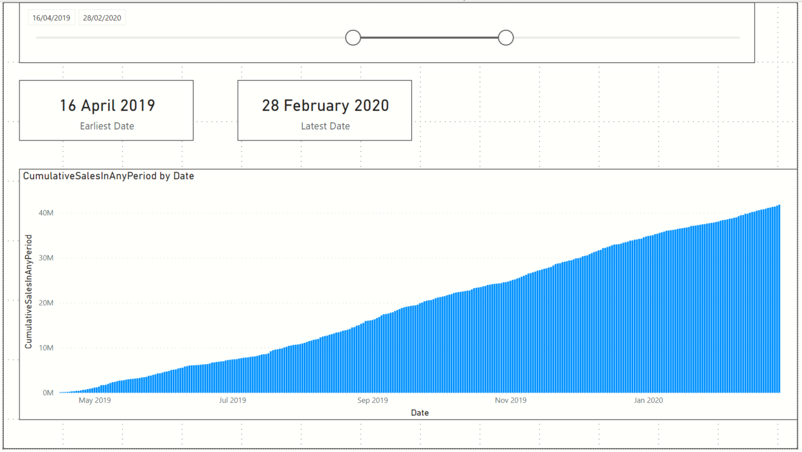
Card showing earliest
MyCalendar[Date]
Slicer on MyCalendar[Date]
Card showing latest
MyCalendar[Date]
Stacked Column Chart visual
X-axis = MyCalendar[Date]
Values = Custom measure CumulativeSalesInAnyPeriod

Slide 3
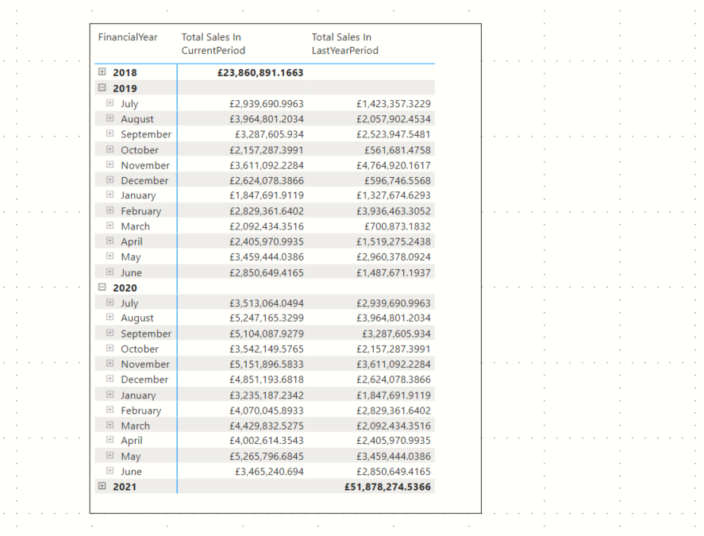
Custom measure TotalSalesInPeriodUsingMyCalendar
Visual hierarchy using the
Financial Year
Financial Month
Day
columns of the MyCalendar[Date]
Custom measure TotalSalesInLastYearPeriodUsingMyCalendar
How do we know this DAX measure works?
The sales for a period in 2020 matches the previous years sales

Slide 4
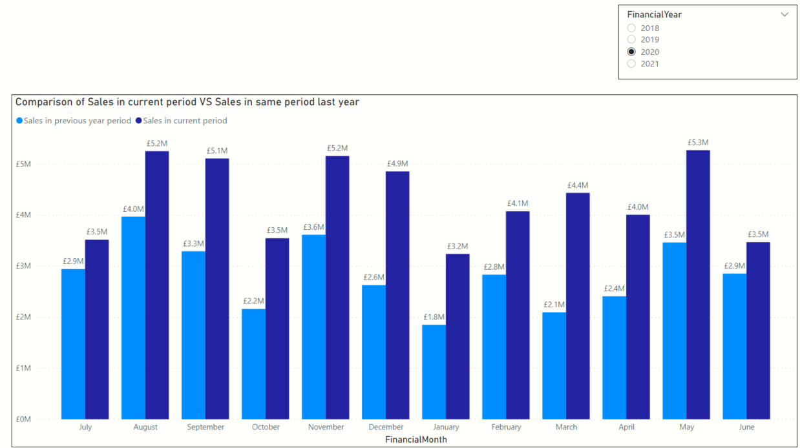
Clustered column chart
X-axis => Financial Month column of MyCalendar
Values => Custom measures
TotalSalesInPeriodUsingMyCalendar
TotalSalesInLastYearPeriodUsingMyCalendar
Slicer
Financial Year column of MyCalendar
Measure TotalSalesInLastYearPeriodUsingMyCalendar
Measure TotalSalesInPeriodUsingMyCalendar

Slide 5
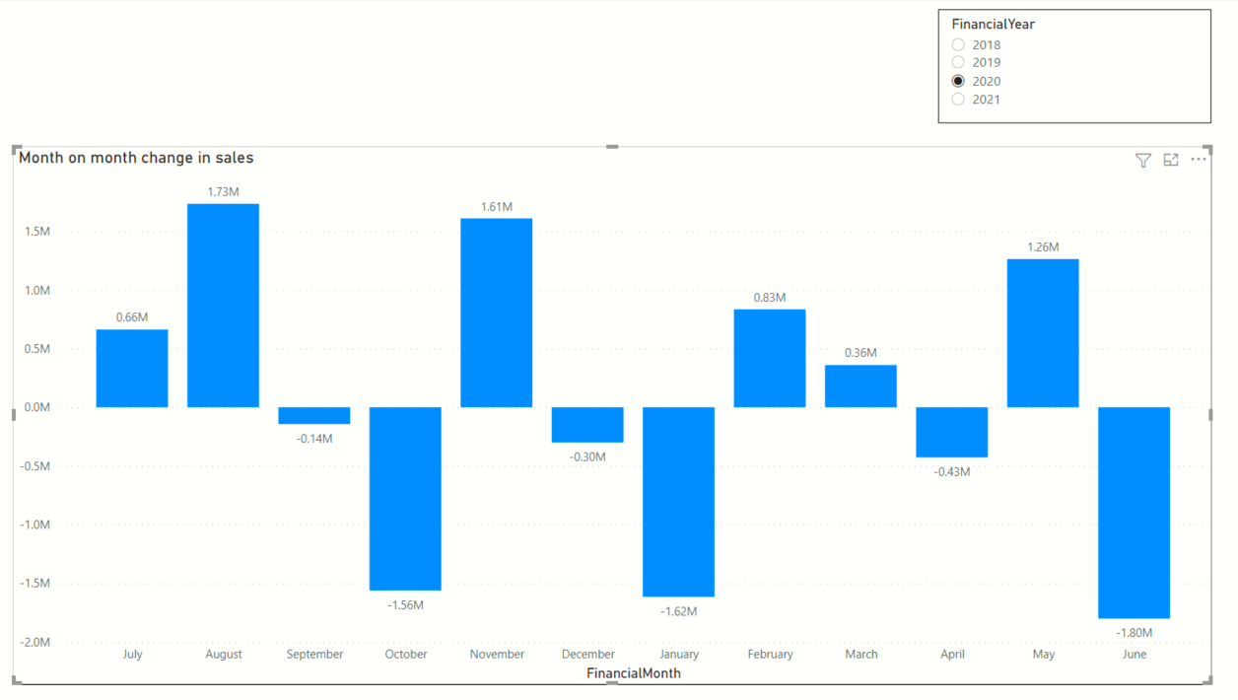
Clustered column chart
X-axis => Financial Month column of MyCalendar
Values => Custom measure MonthOnMonthChangeInSales
Slicer
Financial Year column of MyCalendar
A drop in monthly sales from Dec to January

Slide 6
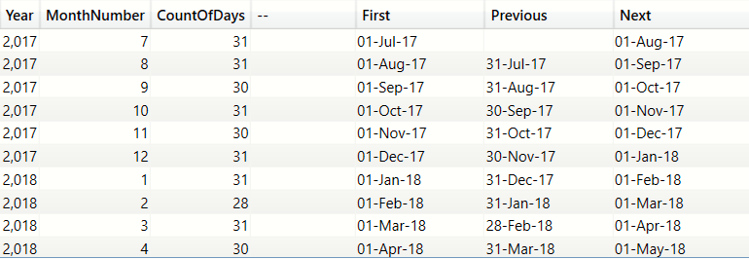
PREVIOUSDAY()
NEXTDAY()
First day in the month
We are in November
First date in current context=Nov 1st
Last date in current context=Nov 30th
PREVIOUSDAY=1 day prior to the first date = 31st Oct
NEXTDAY =1 day after the last date =1st Dec

Slide 7
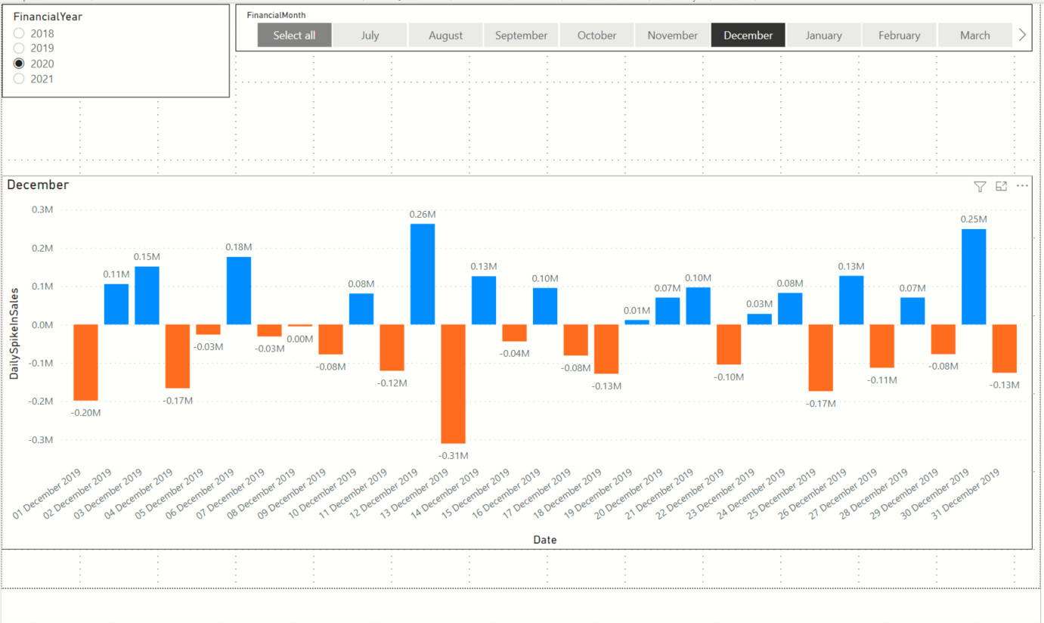
Slicer on MyCalendar[FinancialYear]
Slicer on MyCalendar[FinancialMonth]
Clustered column chart visual
Axis = MyCalendar[Date]
Values = Custom measure ‘DailySpikeInSales’

Slide 8
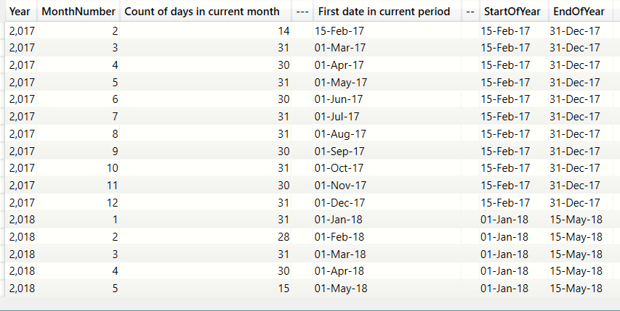
Grouping by Year and Month in descending order
Current context is set to April 2017
STARTOFYEAR= 15-Feb-2017 (the earliest date is 15-Feb-2017, the first available date in the Table)
ENDOFYEAR= 31-Dec-2017
Current context is set to Mar 2018
STARTOFYEAR= 1-Jan-2018 (the first available date in 2018)
ENDOFYEAR =15-May-2017 (last available date in the Date table)

Slide 9
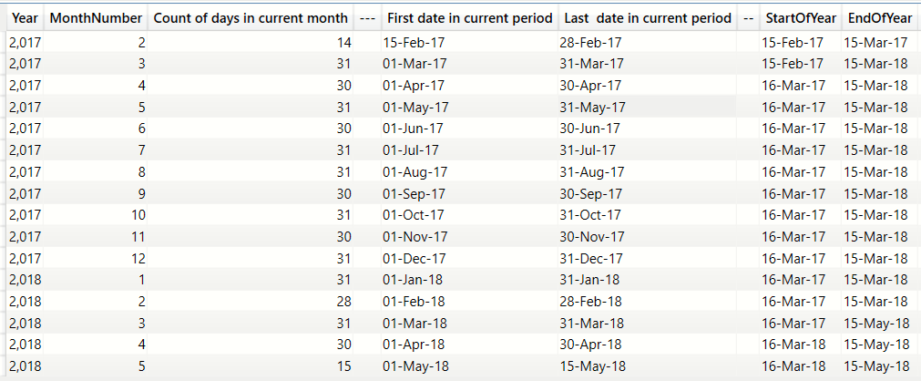
Grouping by Year and Month in descending order
Current context =Feb 2017
Last date in ctx=28 Feb 2017 < 15 Mar 2017
ENDOFYEAR=15-Mar-2017
Current context =Mar 2017
Last date in ctx=31 Mar 2017 > 15 Mar 2017
ENDOFYEAR=15-Mar-2018
Current context =Jan 2018
First date in ctx= 1 Jan 2018 > 15 Mar 2017
STARTOFYEAR=16 Mar 2017
Last date in ctx=31 Jan 2018 < 15 Mar 2018
ENDOFYEAR=15-Mar-2018

